Slide 1






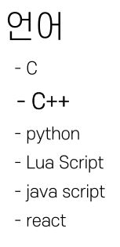
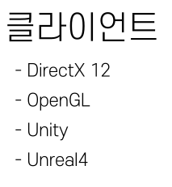
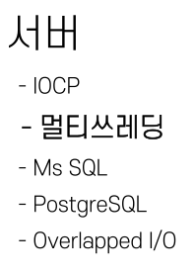


Slide 2




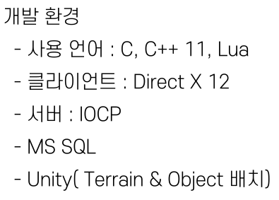
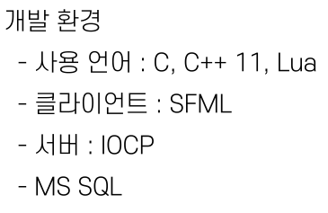


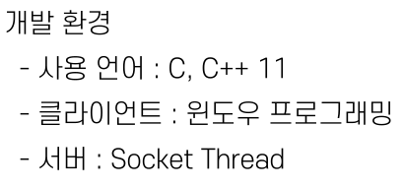


Slide 3


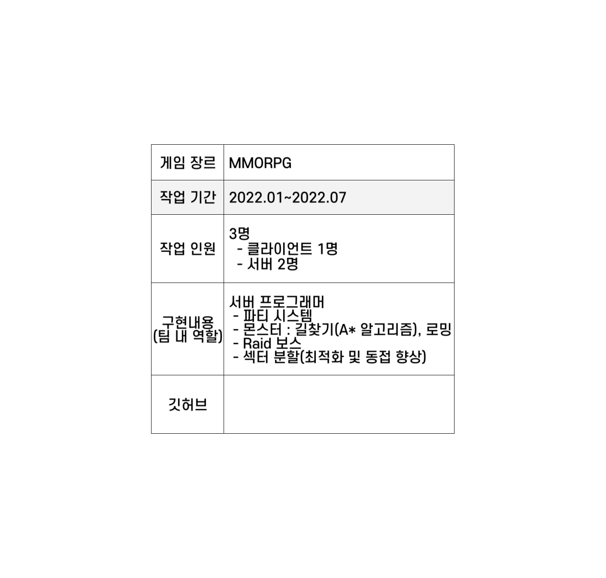
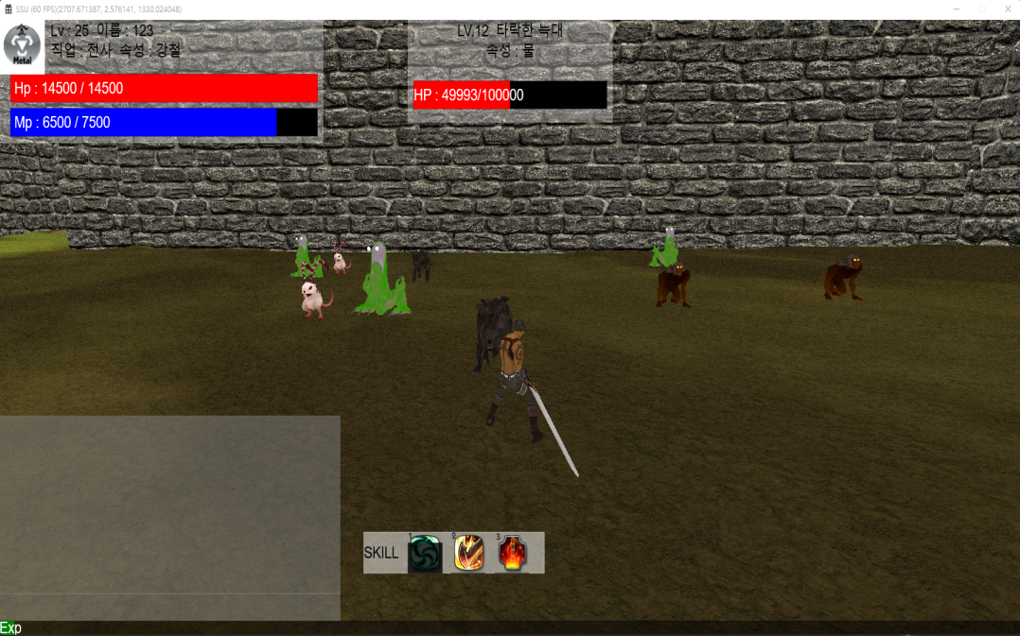
https://github.com/hjs0913/SSU

Slide 4



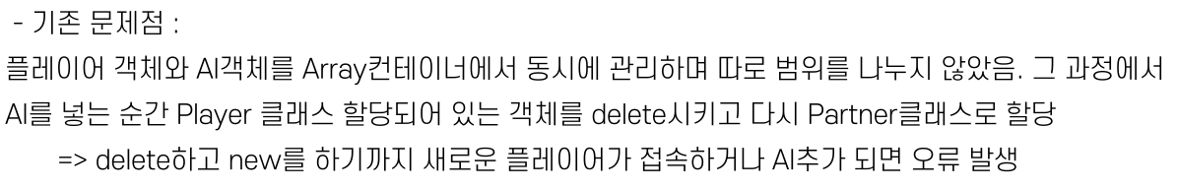



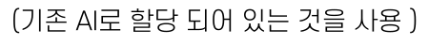


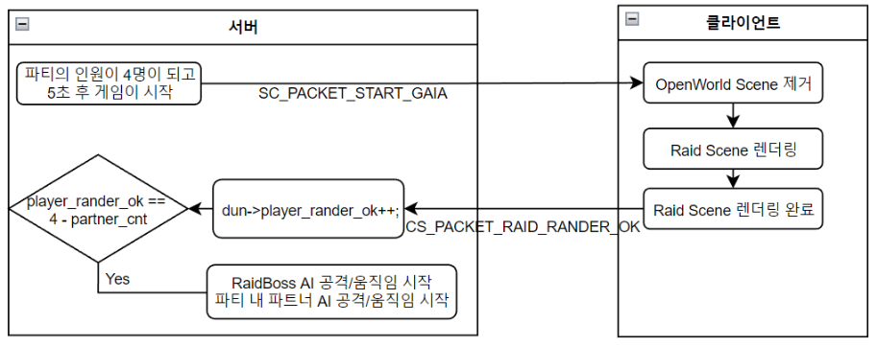

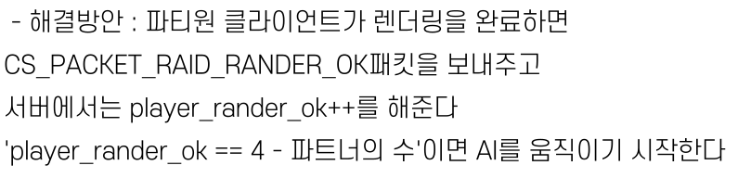
Player | AI | AI | Player | AI | … | Player | Player | Player | Player
Player | Player | Player | Player | Player | … | AI | AI | … | AI

Slide 5














my_id = 99999;
my_element = 0;
my_lv = 100;
my_name = "가이아";
my_hp = 1000000;
my_physical_attack = 350;
my_magical_attck = 400;
my_physical_defence = 500;
my_magical_defence = 350;
my_basic_attack_factor = 50;
my_defence_factor = 0.0018;
my_x = 300;
my_y = 0;
my_z = 300;
function set_uid(id)
my_id = id;
return my_element, my_lv, my_name, my_hp, my_physical_attack, my_magical_attck,
my_physical_defence, my_magical_defence, my_basic_attack_factor, my_defence_factor;
end
raid_gaia.lua
fallen_frog.lua
my_id = 99999;
my_element = 6;
my_lv = 19;
my_name = "타락한 개구리";
my_hp = 120000;
my_physical_attack = 180;
my_magical_attck = 0;
my_physical_defence = 300;
my_magical_defence = 130;
my_basic_attack_factor = 10;
my_defence_factor = 0.0002;
my_x = 0;
my_y = 0;
my_z = 0;
min_x = 1900;
max_x = 2200;
min_z = 3080;
max_z = 3380;
function set_uid(id, x, y, z)
my_id = id;
my_x = x;
my_y = y;
my_z = z;
return my_element,my_lv, my_name, my_hp, my_physical_attack, my_magical_attck,
my_physical_defence, my_magical_defence, my_basic_attack_factor, my_defence_factor;
end

Slide 6

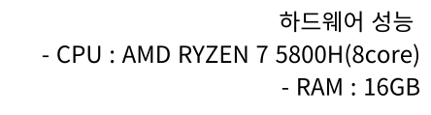


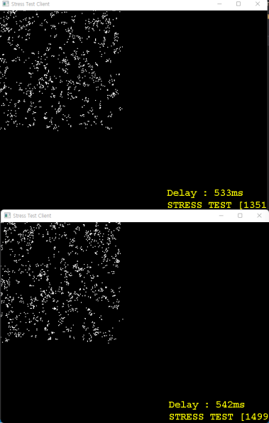
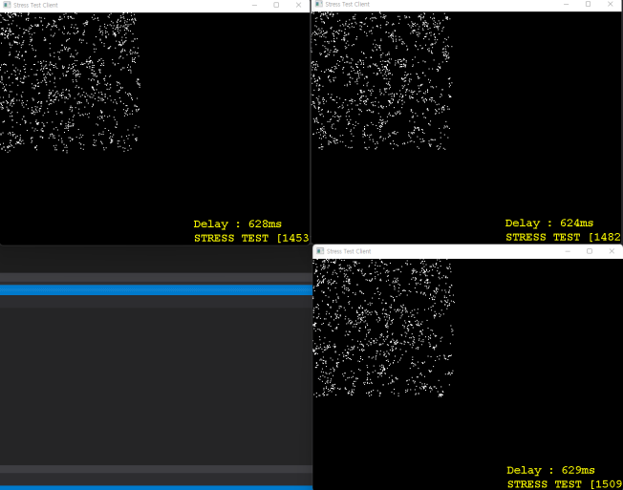

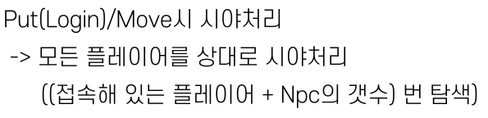


Slide 7
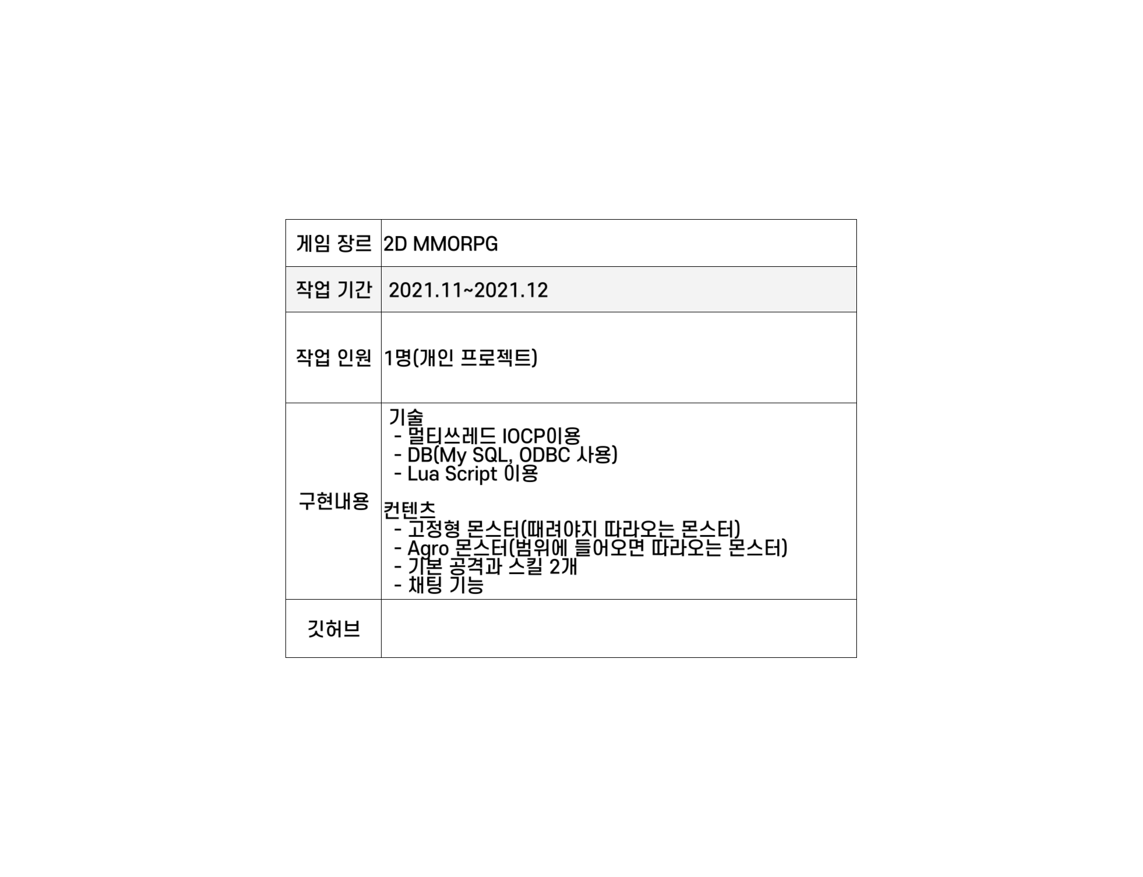


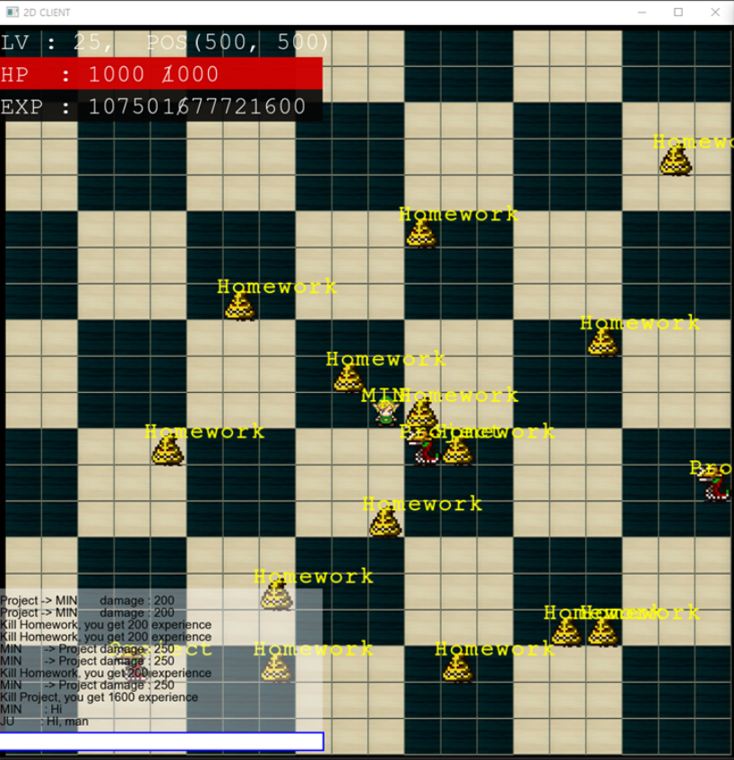
https://github.com/Asias-ara/2021-2GameServer-TermProject

Slide 8



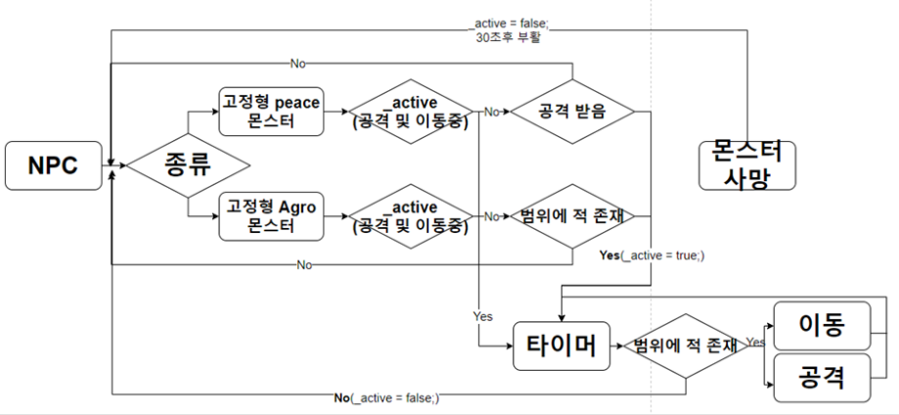

class Npc
{
protected:
char_name[MAX_NAME_SIZE];
int_id;
int_hp;
int_maxhp;
short_lv;
int_exp;
short_x, _y;
TRIBE_tribe;
STATE_state;
atomic_bool_active;// NPC가 가만히 안있고 움직일때
public:
mutexstate_lock;
mutexlua_lock;
lua_State* L;

Slide 9





sprintf_s(temp, sizeof(temp), "EXEC search_player %s", login_id);
wchar_t* exec;
int strSize = MultiByteToWideChar(CP_ACP, 0, temp, -1, NULL, NULL);
exec = new WCHAR[strSize];
MultiByteToWideChar(CP_ACP, 0, temp, sizeof(temp) + 1, exec, strSize);
retcode = SQLExecDirect(hstmt, (SQLWCHAR*)exec, SQL_NTS);
if (retcode == SQL_SUCCESS || retcode == SQL_SUCCESS_WITH_INFO) {
retcode = SQLBindCol(hstmt, 1, SQL_C_LONG, &c_id, 100, &cbP_id);
retcode = SQLBindCol(hstmt, 2, SQL_C_WCHAR, c_name, MAX_NAME_SIZE, &cbP_name);
retcode = SQLBindCol(hstmt, 3, SQL_C_SHORT, &c_x, 100, &cbP_x);
retcode = SQLBindCol(hstmt, 4, SQL_C_SHORT, &c_y, 100, &cbP_y);
retcode = SQLBindCol(hstmt, 5, SQL_C_LONG, &c_hp, 100, &cbP_hp);
retcode = SQLBindCol(hstmt, 6, SQL_C_SHORT, &c_lv, 100, &cbP_lv);
retcode = SQLBindCol(hstmt, 7, SQL_C_LONG, &c_exp, 100, &cbP_exp);
retcode = SQLBindCol(hstmt, 8, SQL_C_LONG, &c_maxhp, 100, &cbP_maxhp);
sprintf_s(temp, sizeof(temp), "EXEC save_player_info %d, %d, %d, %d, %d, %d, %d",
pl->get_login_id(), pl->get_x(), pl->get_y(), pl->get_hp(),
pl->get_lv(), pl->get_exp(), pl->get_maxhp());
wchar_t* exec;
int strSize = MultiByteToWideChar(CP_ACP, 0, temp, -1, NULL, NULL);
exec = new WCHAR[strSize];
MultiByteToWideChar(CP_ACP, 0, temp, sizeof(temp) + 1, exec, strSize);
retcode = SQLExecDirect(hstmt, (SQLWCHAR*)exec, SQL_NTS);
if (retcode == SQL_SUCCESS || retcode == SQL_SUCCESS_WITH_INFO) {
SQLLEN* pcrow = new SQLLEN;
retcode = SQLRowCount(hstmt, pcrow);
ALTER PROCEDURE [dbo].[save_player_info]
@id_param int,
@x_param int,
@y_param int,
@hp_param int,
@lv_param int,
@exp_param int,
@maxhp_param int
AS
BEGIN
SET NOCOUNT ON;
UPDATE player_data SET p_x = @x_param, p_y = @y_param, p_hp = @hp_param, p_lv = @lv_param, p_exp = @exp_param, p_maxhp = @maxhp_param WHERE p_id = @id_param
END
ALTER PROCEDURE [dbo].[search_player]
@param int
AS
BEGIN
SET NOCOUNT ON;
SELECT p_id, p_name, p_x, p_y, p_hp, p_lv, p_exp, p_maxhp FROM player_data WHERE p_id = @param
END

Slide 10
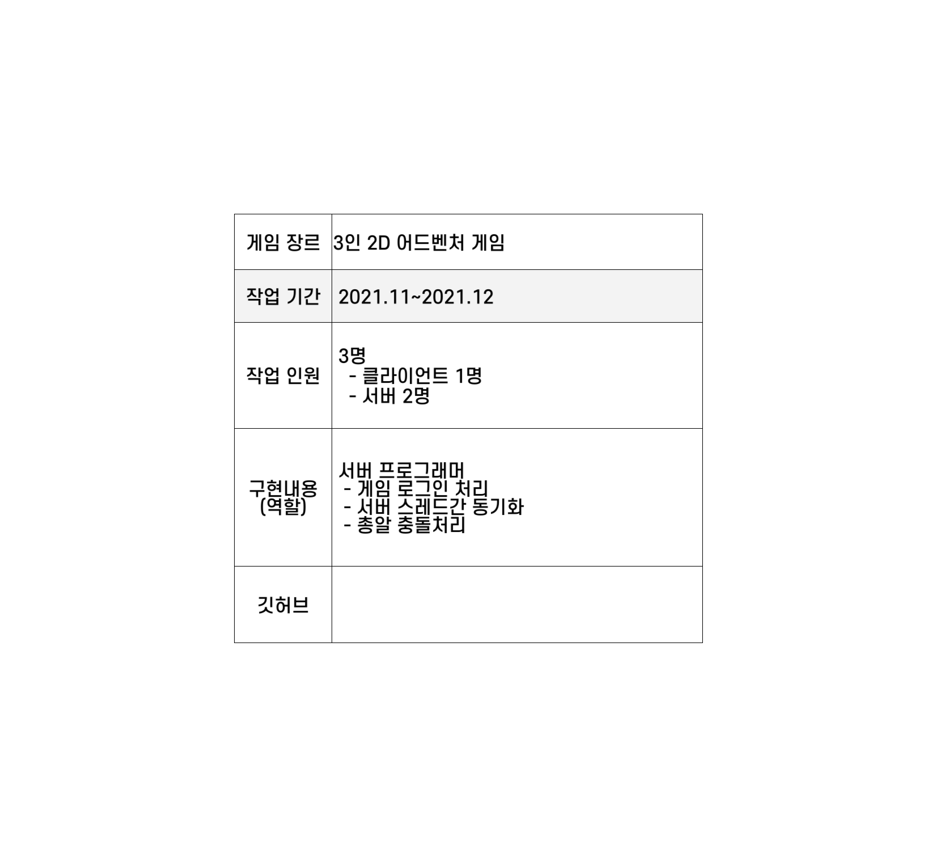


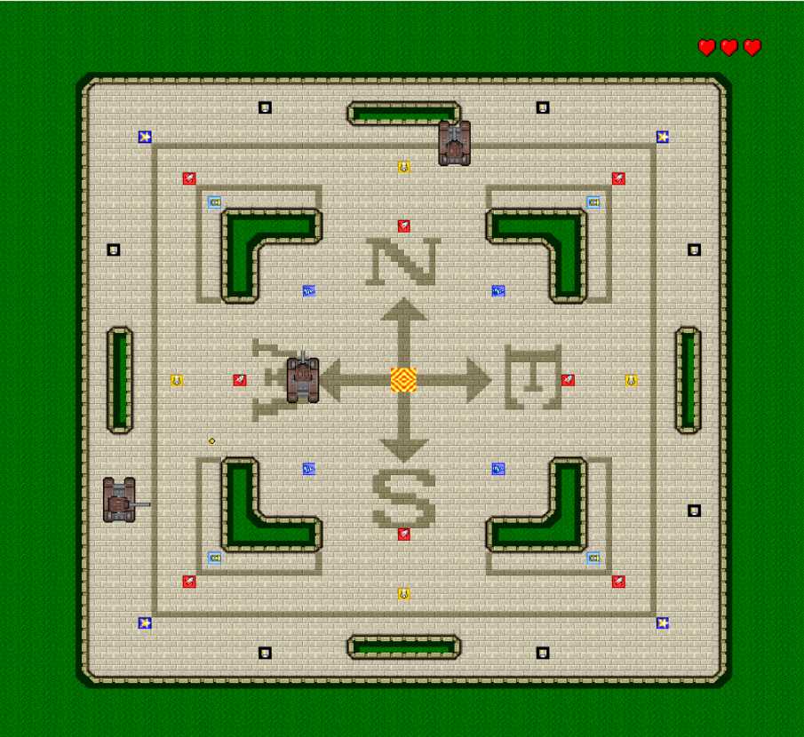
https://github.com/Asias-ara/NGP_TermProject

Slide 11



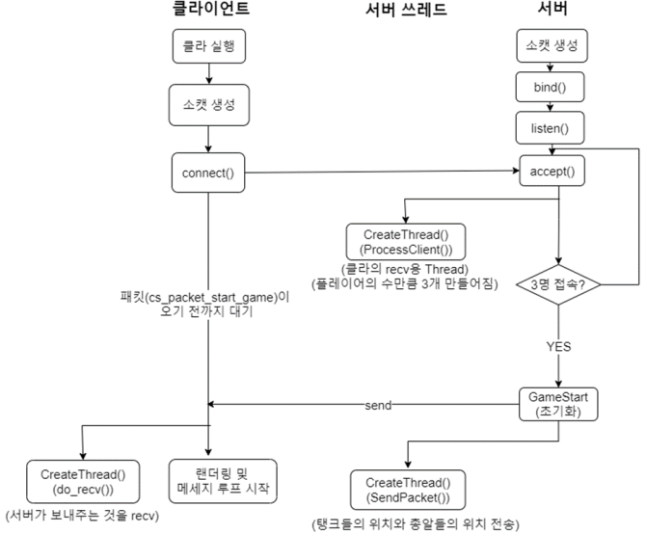
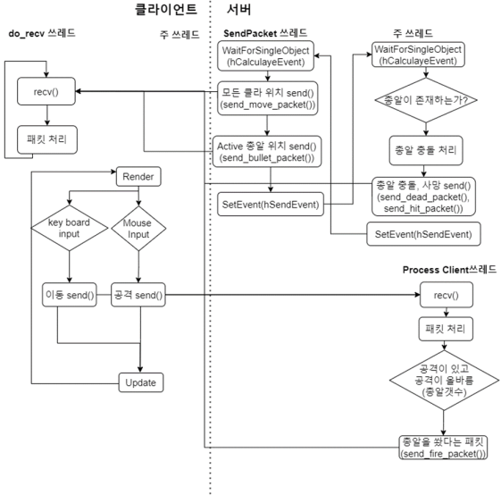
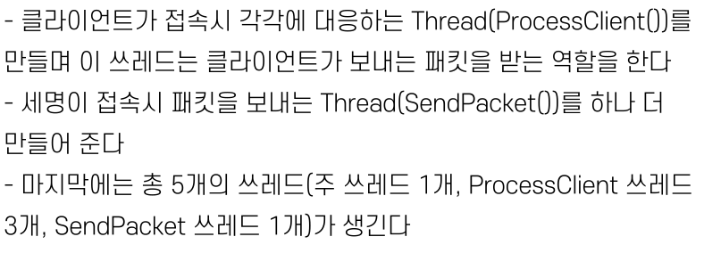
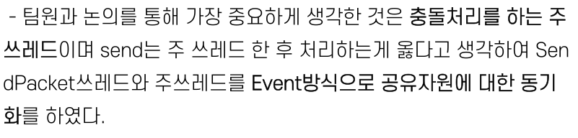

Slide 12



https://www.youtube.com/watch?v=TY211GPtiLI
https://www.youtube.com/watch?v=fxH1n6ZDOX8

